Slide 1
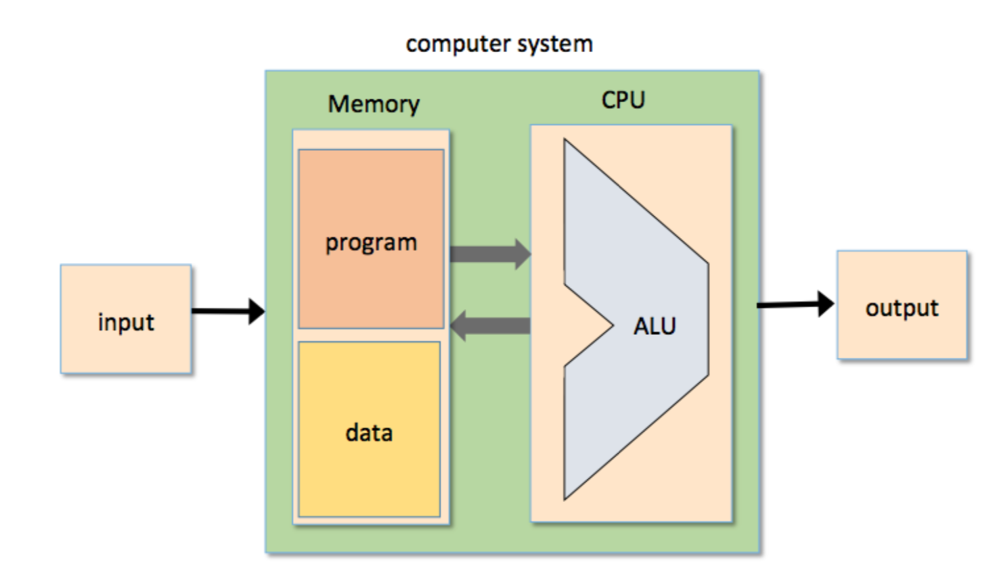

Slide 2
The Hack computer
A 16-bit machine consisting of the following elements:
Both memory chips are 16-bit wide and have 15-bit address space.

Slide 3
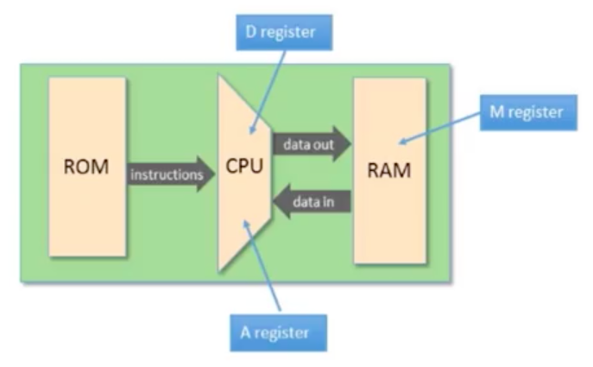
Working with registers and memory
D: data register
A: address/data register
M: the currently selected memory cell, M=RAM[A]

Slide 4
The Hack computer
A 16-bit machine consisting of the following elements:
Data memory: RAM – an addressable sequence of registers
Instruction memory: ROM – an addressable sequence of registers
Registers: D, A, M, where M stands for RAM[A]
Processing: ALU, capable of computing various functions
Program counter: PC, holding an address
Control: The ROM is loaded with a sequence of 16-bit instructions, one per memory location, beginning at address 0. Fetch-execute cycle: later
Instruction set: Two instructions: A-instruction, C-instruction.

Slide 5
The A-instruction
@value // A ← value
Used for:
Entering a constant value ( A = value)
Coding example:
@17 // A = 17
D = A // D = 17
Selecting a RAM location ( register = RAM[A])
@17 // A = 17
D = M // D = RAM[17]
M = -1 // RAM[17]=-1
Selecting a ROM location ( PC = A )
@17 // A = 17
JMP // fetch the instruction
// stored in ROM[17]

Slide 6
The C-instruction
dest = comp ; jump
Both dest and jump are optional.
First, we compute something.
Next, optionally, we can store the result, or use it to jump to somewhere to continue the program execution.
comp:
0, 1, -1, D, A, !D, !A, -D, -A, D+1, A+1, D-1, A-1, D+A, D-A, A-D, D&A, D|A
M, !M, -M, M+1, M-1, D+M, D-M, M-D, D&M, D|M
dest: null, A, D, M, MD, AM, AD, AMD
Compare to zero. If the condition holds, jump to ROM[A]
jump: null, JGT, JEQ, JLT, JGE, JNE, JLE, JMP

Slide 7
The C-instruction
dest = comp ; jump
Computes the value of comp
Stores the result in dest
If (the condition jump compares to zero is true), goto the instruction at ROM[A].

Slide 8
The C-instruction
dest = comp ; jump
comp:
0, 1, -1, D, A, !D, !A, -D, -A, D+1, A+1, D-1, A-1, D+A, D-A, A-D, D&A, D|A
M, !M, -M, M+1, M-1, D+M, D-M, M-D, D&M, D|M
dest: null, A, D, M, MD, AM, AD, AMD
jump: null, JGT, JEQ, JLT, JGE, JNE, JLE, JMP
Example: set the D register to -1
D = -1
Example: set RAM[300] to the value of the D register minus 1
@300
M = D-1
Example: if ((D-1) == 0) goto ROM[56]
@56
D-1; JEQ

Slide 9
Hack programming reference card
Hack commands:
A-command: @value // set A to value
C-command: dest = comp ; jump // dest = and ;jump // are optional
Where:
comp =
0 , 1 , -1 , D , A , !D , !A , -D , -A , D+1 , A+1 , D-1, A-1 , D+A , D-A , A-D , D&A , D|A,
M , !M , -M , M+1, M-1 , D+M, D-M, M-D, D&M, D|M
dest = M, D, A, MD, AM, AD, AMD, or null
jump = JGT , JEQ , JGE , JLT , JNE , JLE , JMP, or null
In the command dest = comp; jump, the jump materialzes if (comp jump 0) is true. For example, in D=D+1,JLT, we jump if D+1 < 0.

Slide 10
The A-instruction
symbolic
binary
@value
0value
value is a non-negative decimal number <= 2¹⁵-1 or
A symbol referring to such a constant
value is a 15-bit binary number
Example
@21
0000 0000 0001 0101

Slide 11
The C-instruction
symbolic
binary
dest = comp ; jump
111A C₁C₂C₃C₄ C₅C₆ D₁D₂ D₃J₁J₂J₃
]
comp
dest
jump
not used
opcode

Slide 12
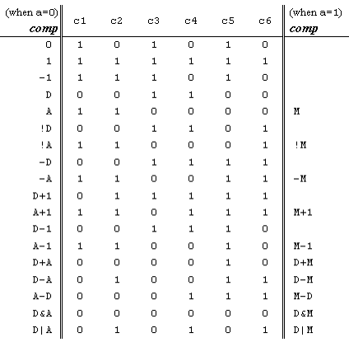

The C-instruction
111A C₁C₂C₃C₄ C₅C₆ D₁D₂ D₃J₁J₂J₃
comp
dest
jump
1 – the most significant bit of a C-instruction is “1”
x₁x₀ – these bits are ignored by the CPU and, by convention, are each always set to “1”
A – this bit specifies the source of the “y” operand of the ALU when it is used in a computation
C₀-C₅ – these six control bits specify the operands and computation to be performed by the ALU
D₂-D₀ – these three bits specify the destination(s) for storing the current ALU output
J₂-J₀ – these three bits specify an arithmetic branch condition, an unconditional branch (jump), or no branching

Slide 13
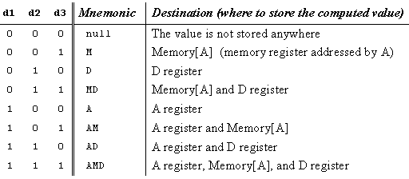
The C-instruction
111A C₁C₂C₃C₄ C₅C₆ D₁D₂ D₃J₁J₂J₃
comp
dest
jump
A D M

Slide 14
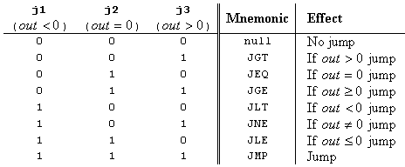
The C-instruction
111A C₁C₂C₃C₄ C₅C₆ D₁D₂ D₃J₁J₂J₃
comp
dest
jump

Slide 15
